Slide 1

A Regression Analysis of Suicide Rates
Group 5:
Melissa Russell, Jonathan Voth, & Nick Wawee
Watch on YouTube

Slide 2
Introduction
Problem
Thousands of people die each year from suicide.
Goal
Aid suicide preventive measures by identifying the factors most significant in predicting suicides.
Males will have higher suicide rates than women.
Elderly adults will not have higher suicide rates than younger adults.
Predictions

Slide 3
Introduction
Our Dataset: “Suicide Rates Overview 1985 to 2016”
Variables Included in our Analysis:
Variable | Response/Regressor | Type
Suicide Rate | Response | Numeric
Year | Regressor | Integer
Sex | Regressor | Factor (2 levels)
Age | Regressor | Factor (6 levels)
GDP | Regressor | Integer
GDP per Capita | Regressor | Integer
Found on Kaggle.com
Reports the suicide rate, sex, year, age group, population, GDP, and generation for 101 countries across the world
Original dataset contains 27,821 rows
We narrow this down by only analyzing rates in the United States (372 rows)

Slide 4
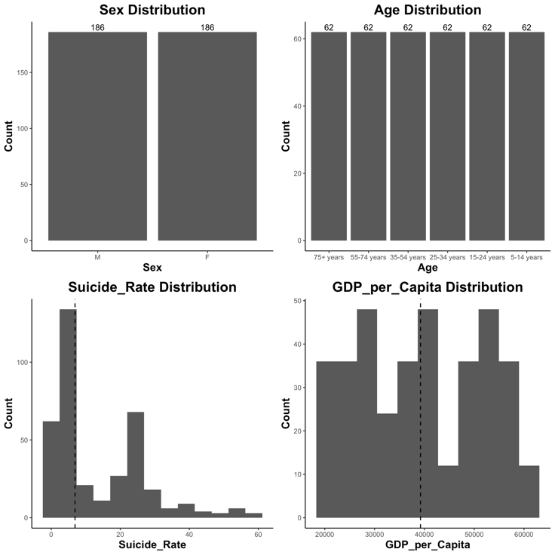

Model Fitting
GDP was removed due to collinearity
Interaction term was included between age and sex
Distributions:
Uniform distribution of categorical regressors
Response variable shows a right skew (Rate = 25-30)
GDP per capita shows a left skew

Slide 5
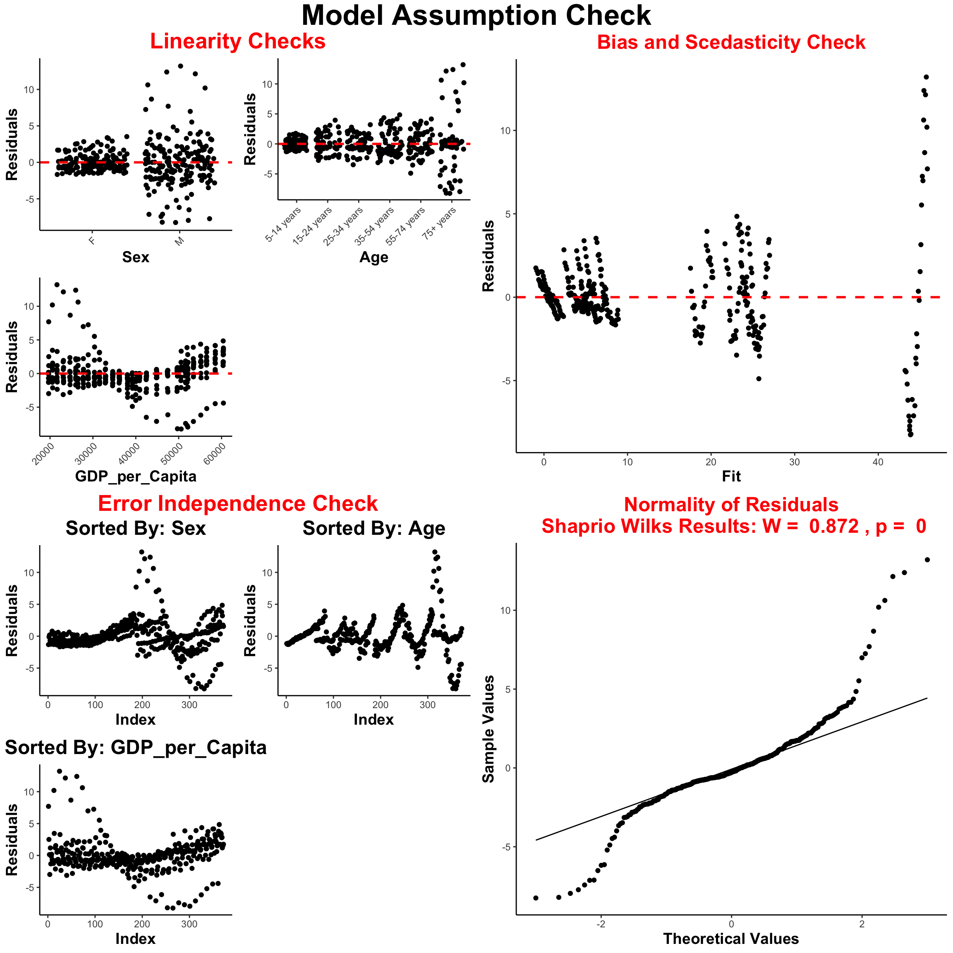
Checking Model Assumptions
Linearity assumption does not hold across different regressors– uneven distributions around zero
Model appears to generally have a constant mean, but is heteroscedastic
Errors appear to be in distinct groups above and below zero
Points on the tails of the distribution that largely deviate from qqline, reject Shapiro Wilks¹ test
¹Royston, Patrick (1982). An extension of Shapiro and Wilk's W test for normality to large samples. Applied Statistics, 31, 115–124. doi: 10.2307/2347973.

Slide 6
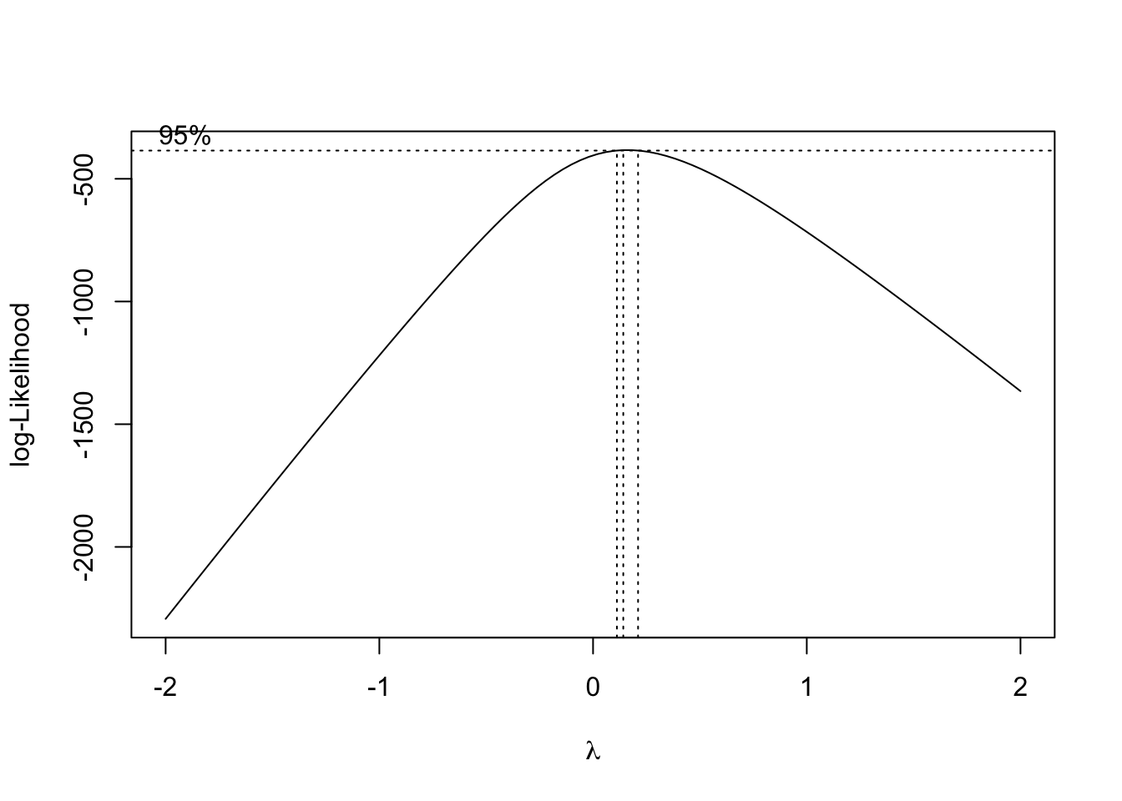
Power Transformation
Suicide rates were transformed by finding the optimal power using the BoxCox method¹
The response variable is iteratively transformed with different powers and the log-likelihood function is evaluated
The power (ƛ) at which the function is maximized is optimal
ƛ = 0.1414 for suicide rates
¹Box, G. E. P. and Cox, D. R. (1964) An analysis of transformations (with discussion). Journal of the Royal Statistical Society B, 26, 211–252.

Slide 7
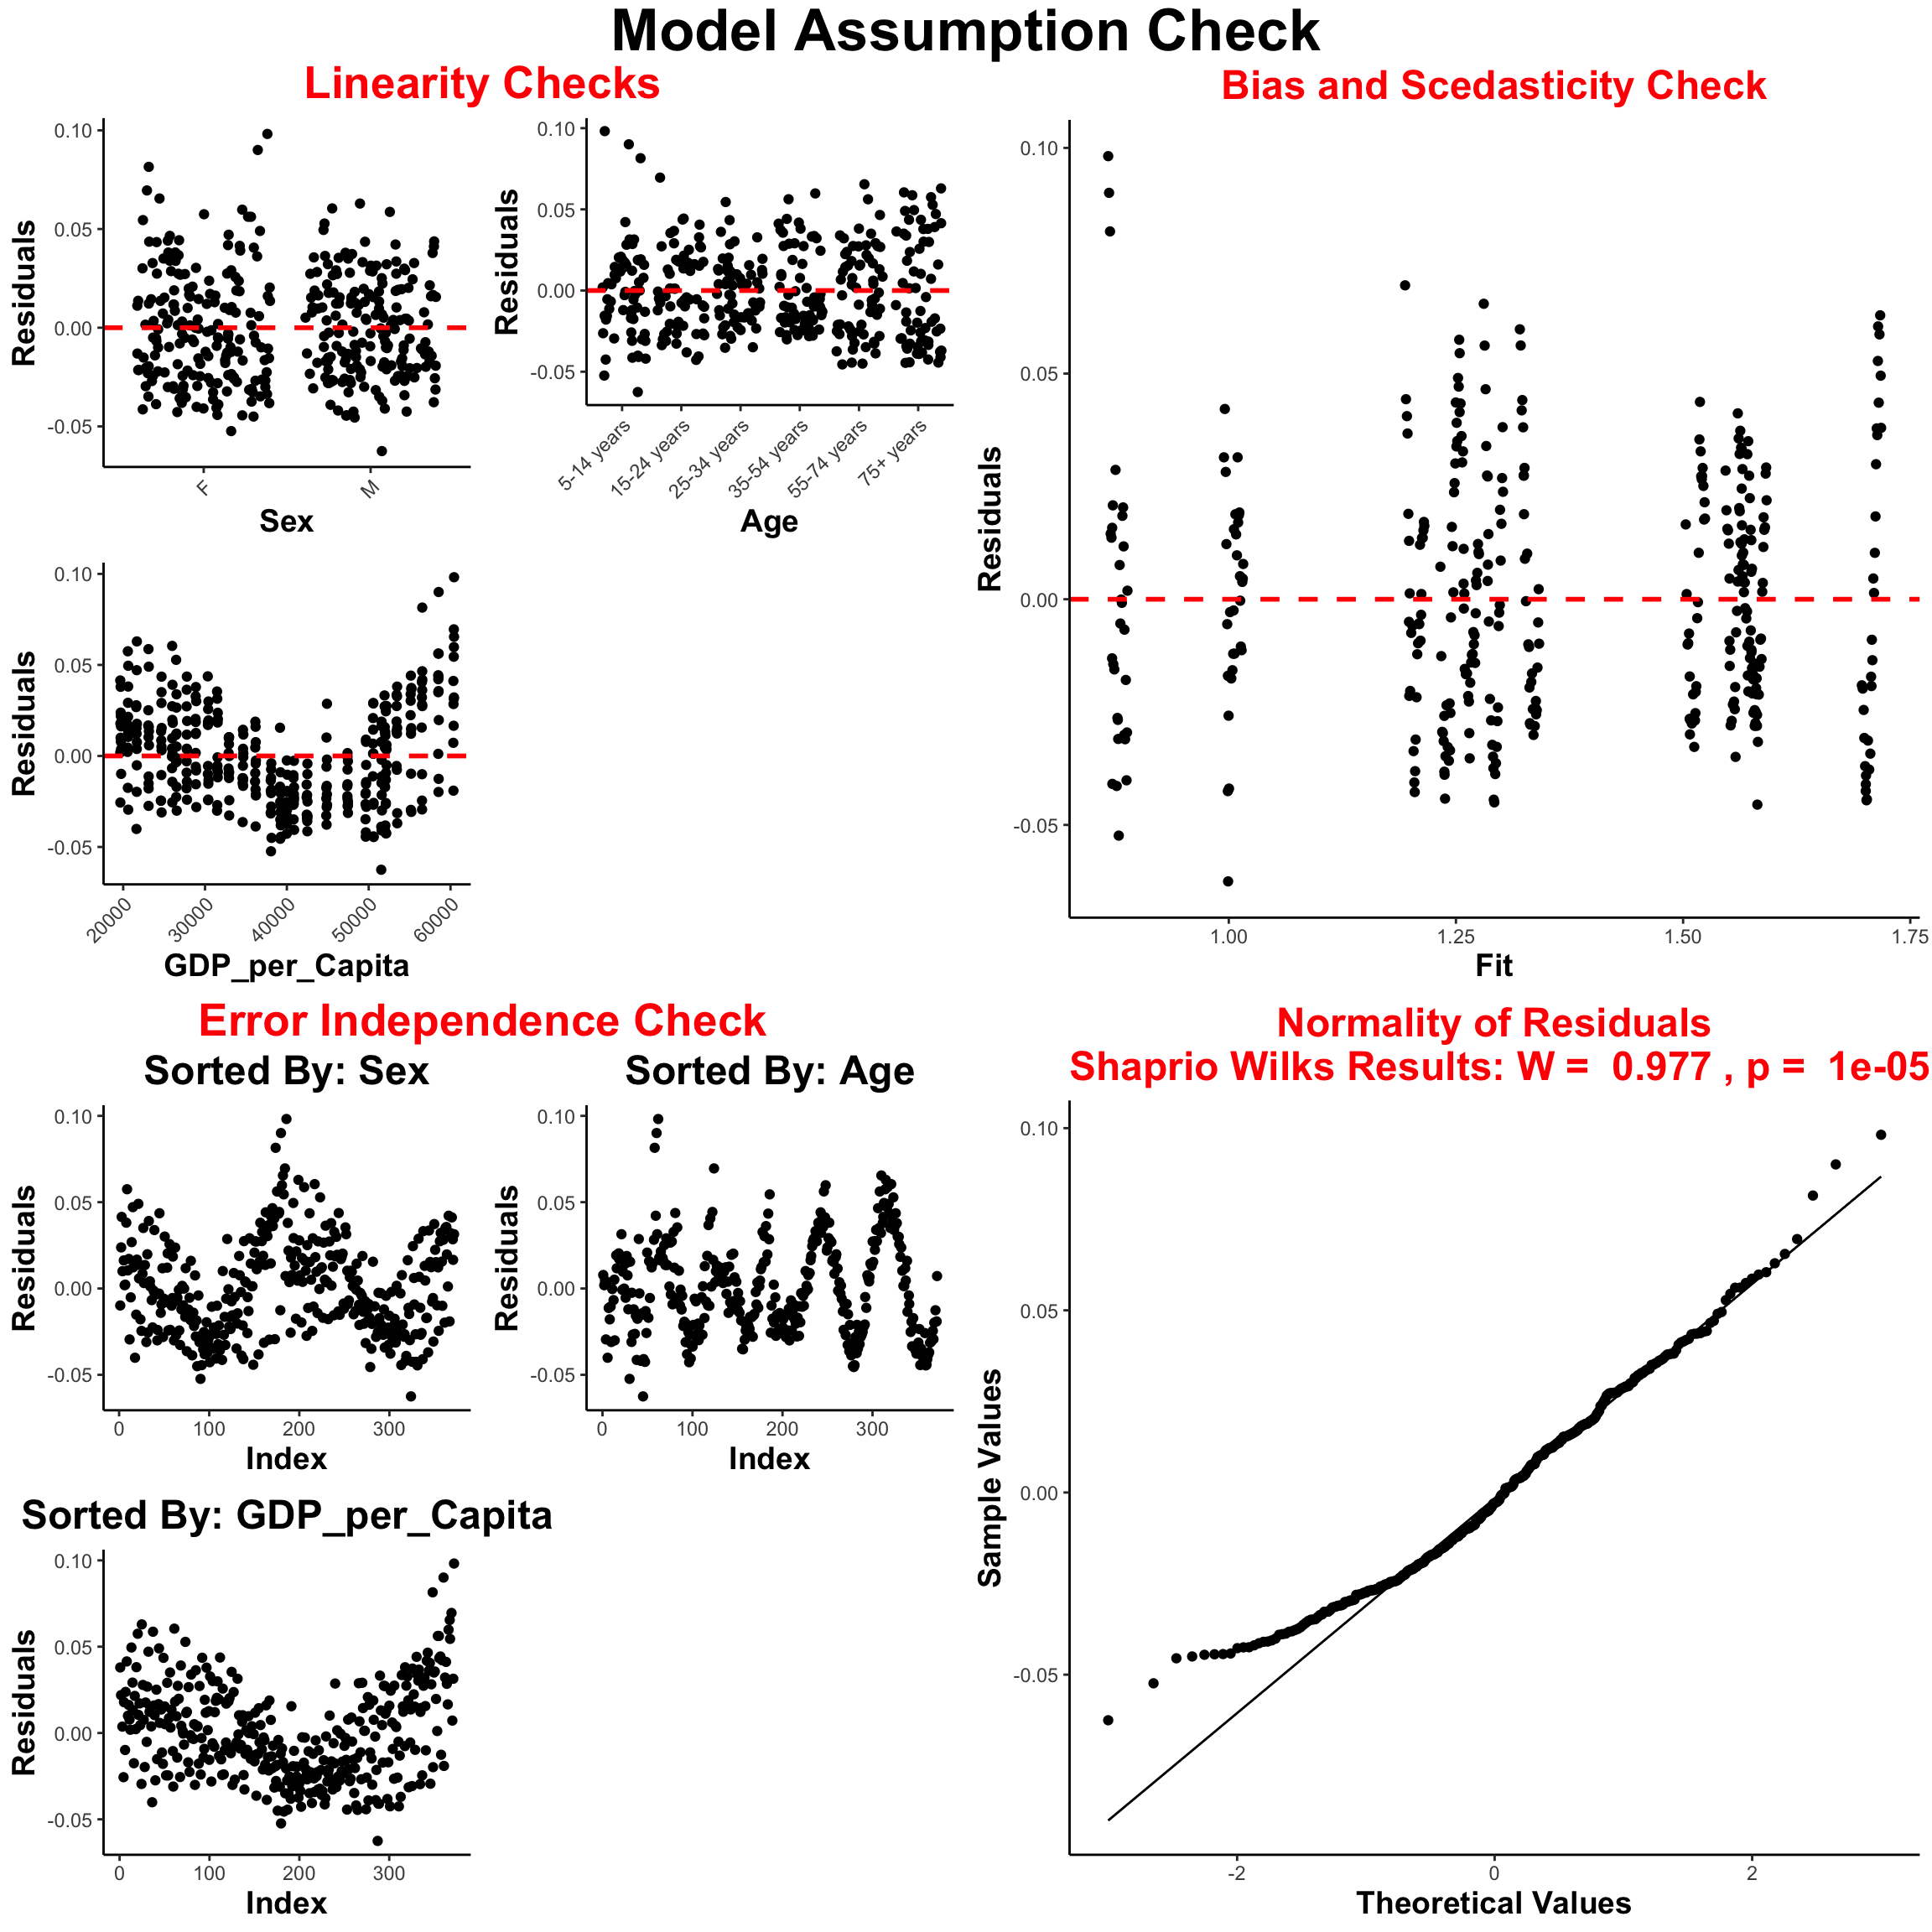
Transformation Validation
Linearity assumption violation alleviated, less grouping above and below zero
Model is now homoscedastic ☺
Errors appear to be less correlated than before, but are still present
Points deviate less from the qqline, residuals appear to be more normal
Shapiro Wilks test still rejects the hypothesis residuals are normal

Slide 8
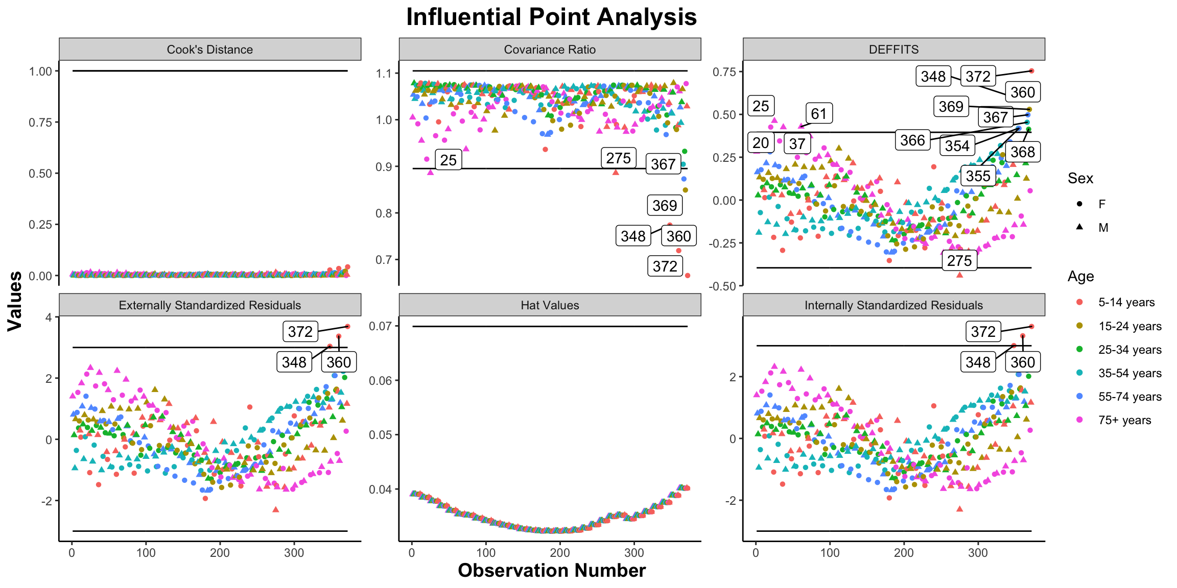
Observation numbers 348, 360, and 372 are both considered as outliers and influential
All appear to be in the 5-14-year age range and female
Males 75+ are considered influential (Observations 25, 37, and 61)

Slide 9
Hypothesis Testing
Do males have a significantly higher suicide rate than females?
H_{o}: β1 = 0 vs. H_{A}: β1 ≠ 0
p-value = < 2e-16; We reject the null hypothesis. There is sufficient evidence to suggest β1 is not equal to 0, meaning the effect of males is significant.
Does age significantly affect suicide rates?
H_{o}: β2 = β3 = β4 = β5 = β6 = 0 vs. H_{A}: At least one ≠ 0
p-value = < 2.2e-16; We reject the null hypothesis. There is sufficient evidence to suggest at least one of β2, β3, β4, β5, β6 is not equal to 0, meaning the effect of age is significant.
Is there evidence of interaction between sex and age?
H_{o}: β8 = β9 = β10 = β11 = β12 = 0 vs. H_{A}: At least one ≠ 0
p-value = < 2.2e-16; We reject the null hypothesis. There is sufficient evidence to suggest at least one of β8, β9, β10, β11, β12 is not equal to 0, suggesting evidence of interaction.

Slide 10
Hypothesis Testing (cont.)
β2, β3, β4, β5, and β6 represent the effect of each sex and age combination for females.
H_{o}: β2 = β3 = β4 = β5 = β6 vs. H_{A}: β2 ≠ β3 ≠ β4 ≠ β5 ≠ β6
Each test resulted in a p-value < 0.05. We have enough evidence to reject the null hypothesis and conclude that suicide rates amongst the different age groups for females is significantly different.
The difference in the male suicide rates amongst the different age groups is represented by β2+β8, β3+β9, β4+β10, β5+β11, and β6+β12.
H_{o}: β2+β8 = β3+β9 = β4+β10 = β5+β11 = β6+β12 vs. H_{A}: β2+β8 ≠ β3+β9 ≠ β4+β10 ≠ β5+β11 ≠ β6+β12
Only two tests resulted in a p-value > 0.05. The difference between males 25-34 years and males 35-54 years is not significant (p-value = 0.05593). Additionally, the difference between the suicide rates in males 35-54 years and males 55-74 years resulted in a p-value of 0.1359. This difference is not significant. This ultimately means that males in these age groups commit suicide at very similar rates.

Slide 11
Results
Coefficient | Estimate | Test Statistic | P-Value | 95% CI
Intercept | 0.8987 | 133.140 | < 2e-16 | (0.885, 0.912)
sexmale | 0.1274 | 18.134 | < 2e-16 | (0.114, 0.141)
age15-24 years | 0.3267 | 46.515 | < 2e-16 | (0.313, 0.341)
age25-34 years | 0.3868 | 55.068 | < 2e-16 | (0.373, 0.401)
age35-54 years | 0.4530 | 64.494 | < 2e-16 | (0.439, 0.467)
age55-74 years | 0.4133 | 58.842 | < 2e-16 | (0.400, 0.427)
age75+ years | 0.3656 | 52.046 | < 2e-16 | (0.352, 0.379)
GDP_per_capita | -5.207e-7 | -4.473 | 1.04e-5 | (-7.5e-7, -2.9e-7)
sexmale: age15-24 years | 0.1815 | 18.271 | < 2e-16 | (0.162, 2.010)
sexmale: age25-34 years | 0.1652 | 16.633 | < 2e-16 | (0.146, 0.185)
sexmale: age35-54 years | 0.1125 | 11.324 | < 2e-16 | (0.093, 0.132)
sexmale: age55-74 years | 0.1627 | 16.377 | < 2e-16 | (0.143, 0.182)
sexmale: age75+ years | 0.3364 | 33.868 | < 2e-16 | (0.317, 0.356)
R² = 0.9872
Adjusted R² = 0.9868

Slide 12
Results (cont.)
Group | Intercept
Male, 5-14 years | 1.0261
Male, 15-24 years | 1.5343
Male, 25-34 years | 1.5781
Male, 35-54 years | 1.5916
Male, 55-74 years | 1.6021
Male, 75+ years | 1.7218
Female, 5-14 years | 0.8987
Female, 15-24 years | 1.2254
Female, 25-34 years | 1.2855
Female, 35-54 years | 1.3517
Female, 55-74 years | 1.3120
Female, 75+ years | 1.2643
Response = (Suicide Rate)^{0.1414}
Slope = -5.207e-7(GDP_per_capita)
Sex and age variables affect the intercept in the model
Trends:
Male suicide rates increase with age (not all differences are significant)
Female suicide rates peak in the 35-54 years age group
Males commit suicide at a higher rate than females

Slide 13
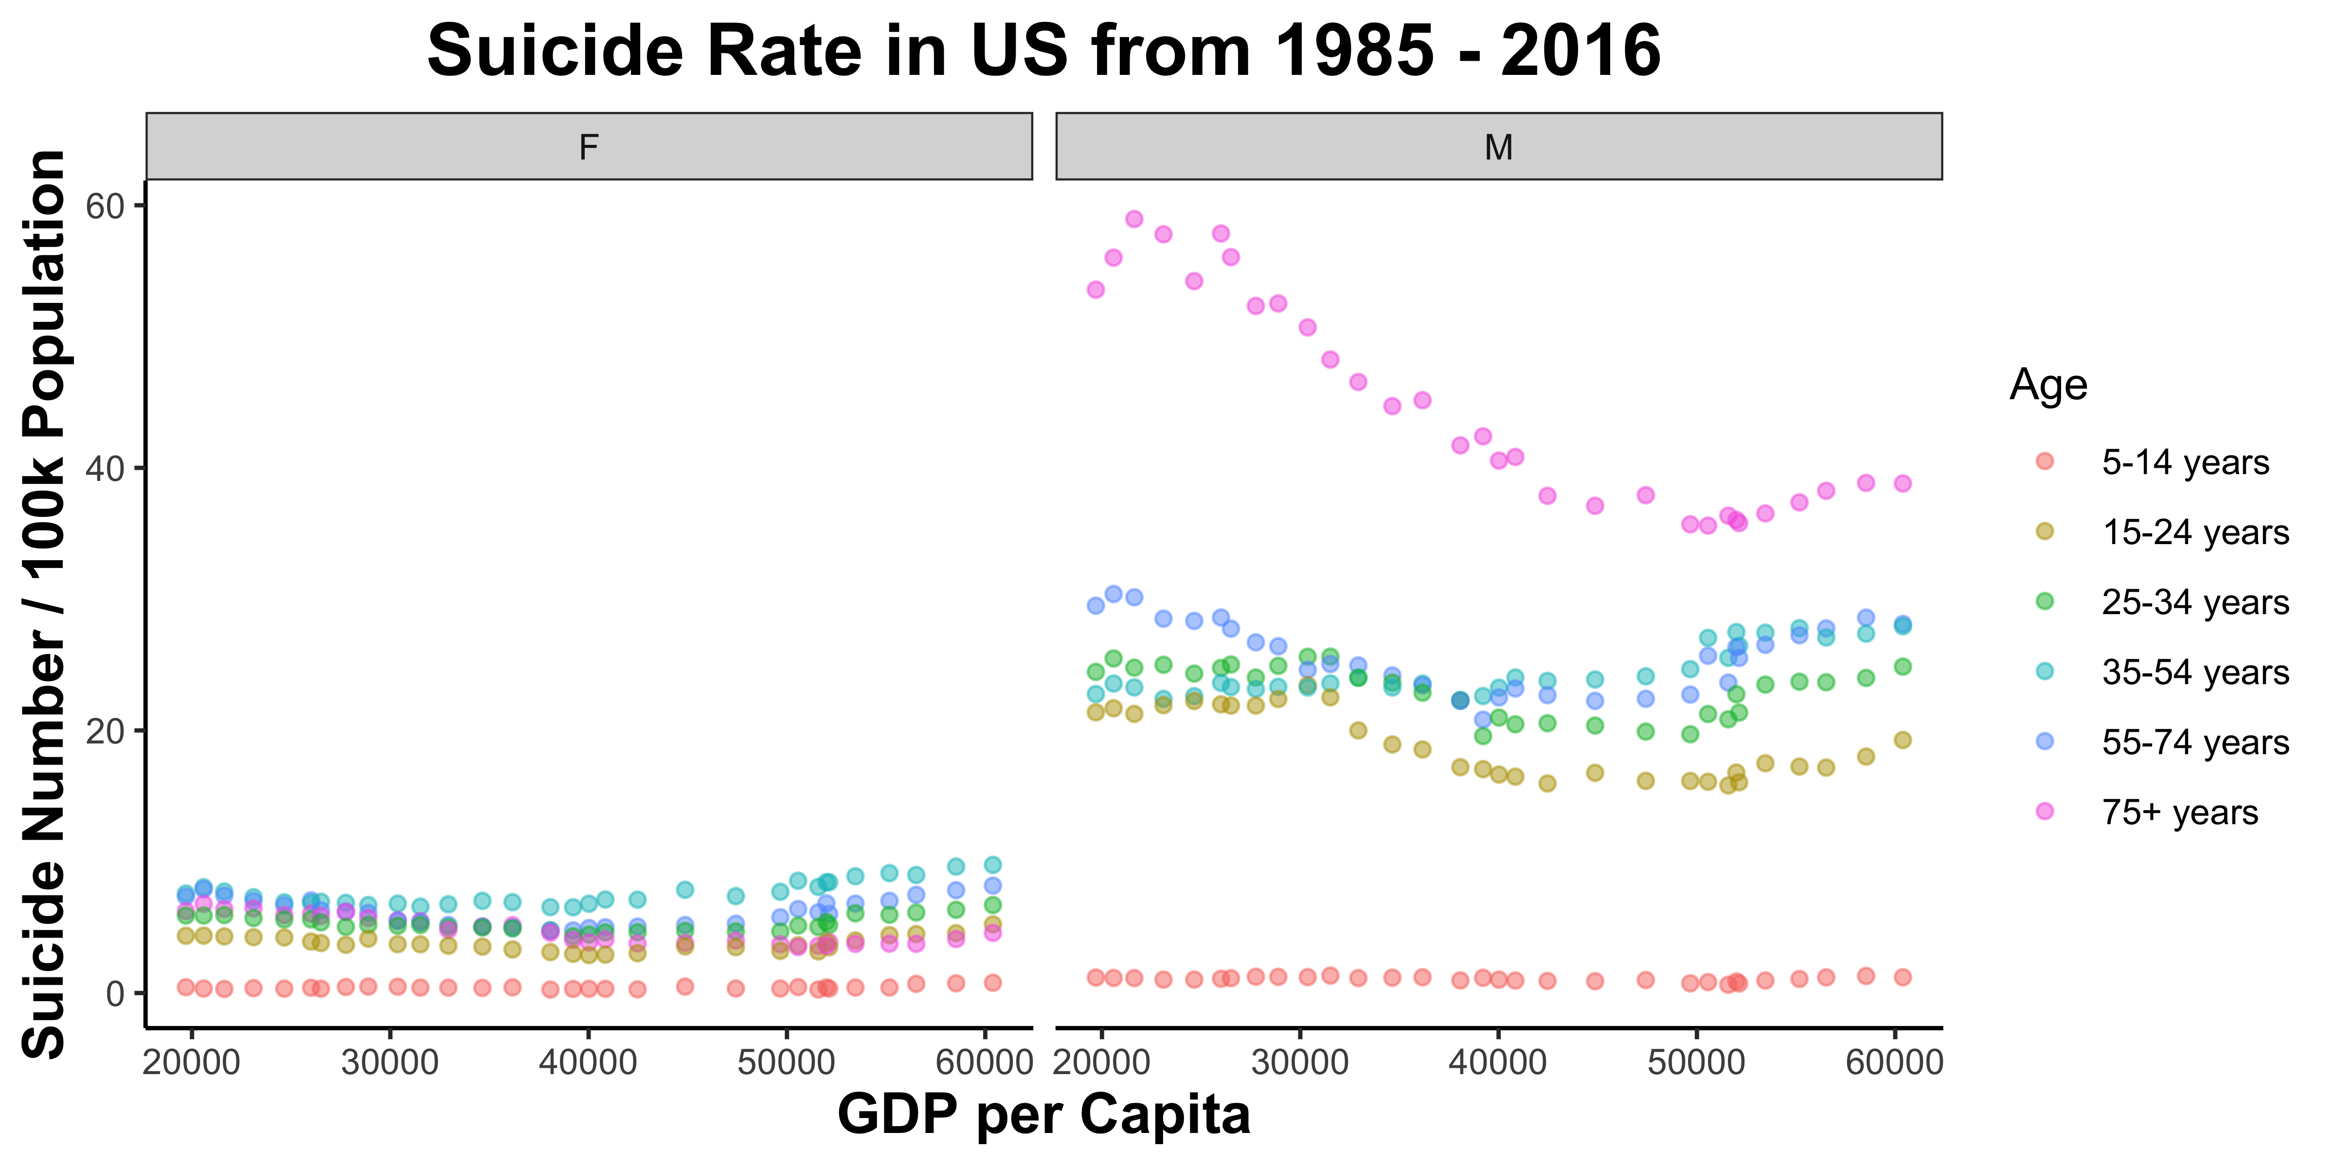


Discussion
Predictions:
Males will have higher suicide rates than women.
Elderly adults will not have higher suicide rates than younger adults.
Results:
Correct; males have higher suicide rates than women.
Suicide rates peak for women at age group 35-54 years, but increase with age for men, with men being 75+ years having the highest rates.

Slide 14
Conclusion
Very strong model (R² > 98%)
Significant regressors:
Sex
Age
GDP per capita
Based on these results, we can better target suicide preventive measures
75+ years men

Slide 15
Thank you!

